Slide 1




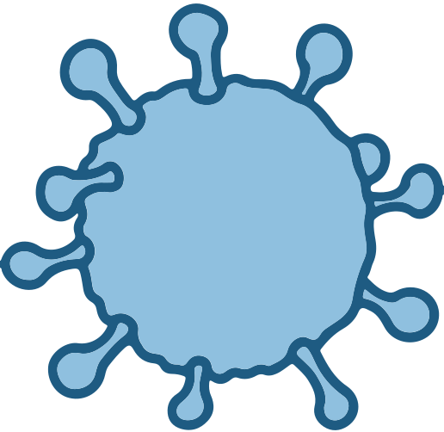
medpocket
presented by Hkimi Mohamed Amin
december 2023

Slide 2
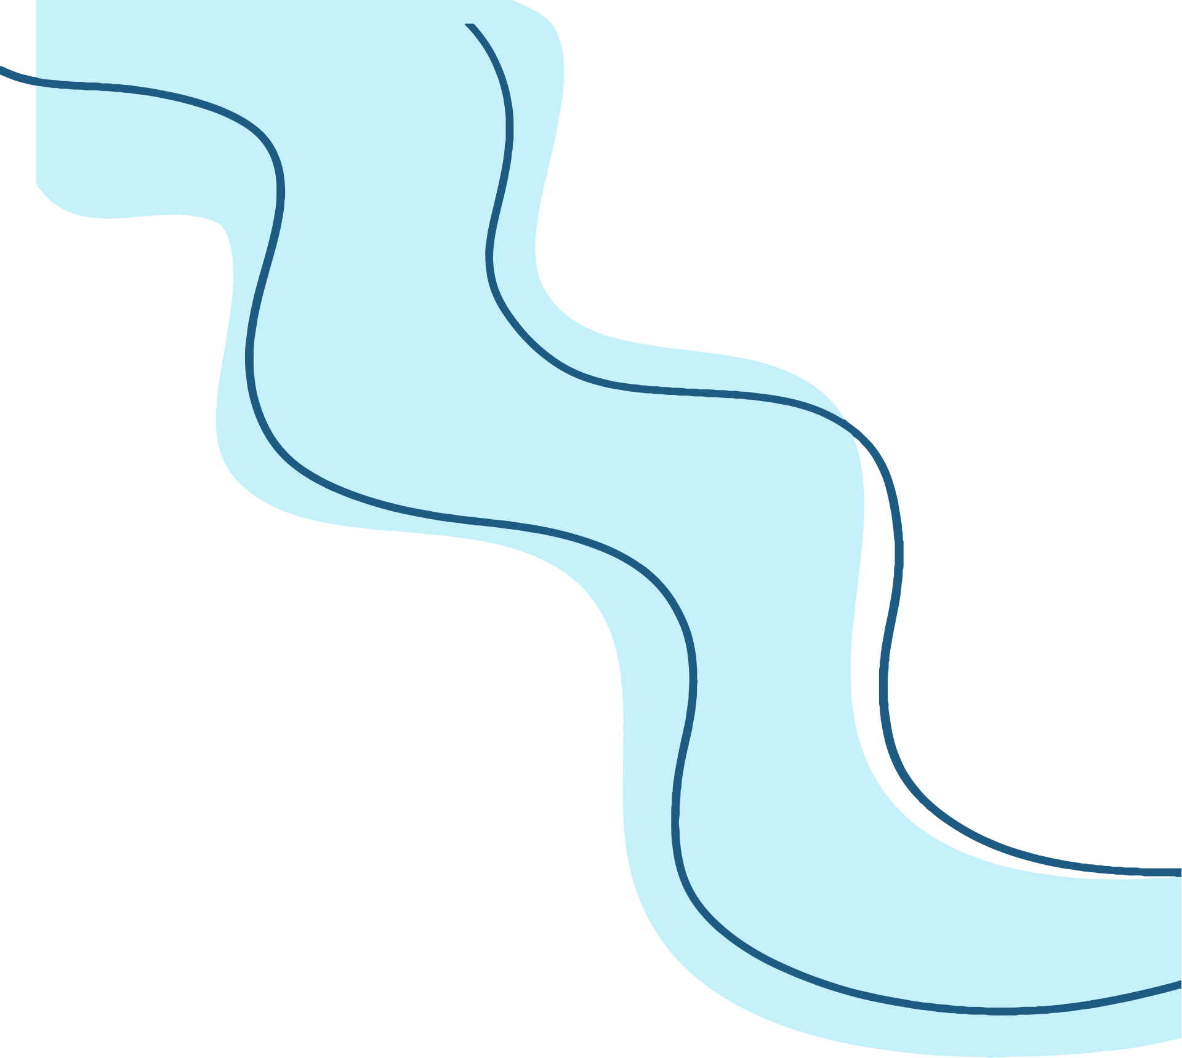
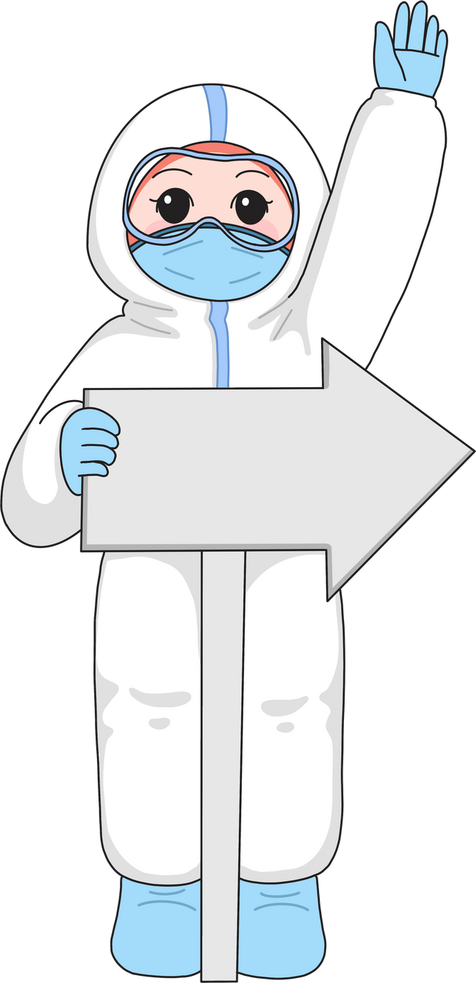
Introduction
The Medical Health Application is a comprehensive platform designed to enhance the interaction between healthcare providers and patients. The application serves two primary actors: doctors and patients.

Slide 3

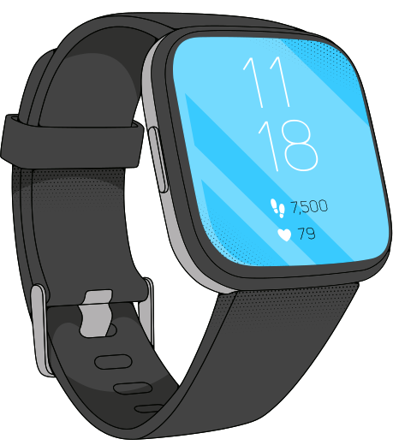
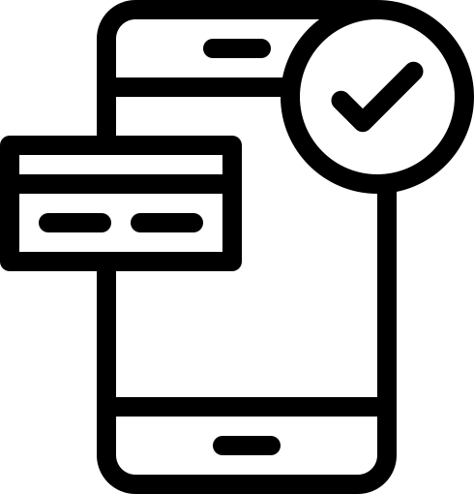
01
Smartwatch
Main
Components
02
Mobile Application

Slide 4

integration
Real-time synchronization of health data.
Wi-Fi for updates and cloud synchronization.
Seamless connectivity between smartwatch and mobile application.

Slide 5
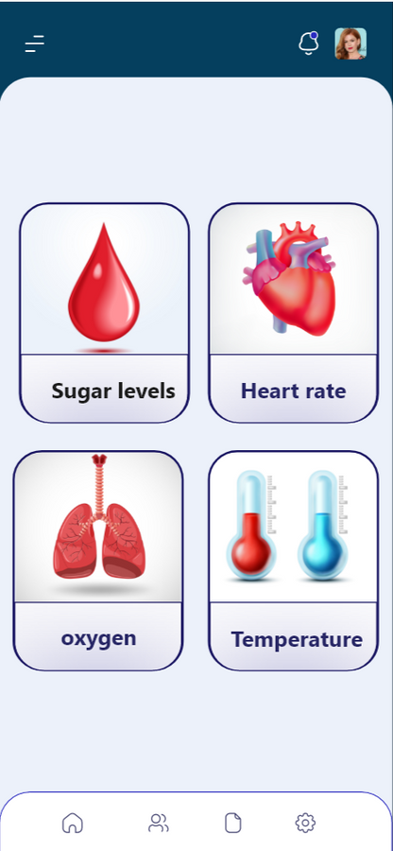
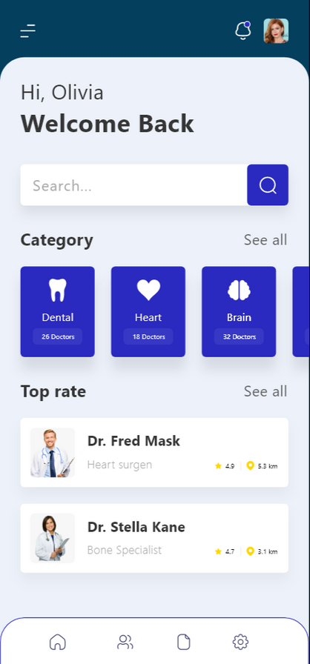




MOBILE INTERFACE
EASY TO CONTROL
user friendly interfaces easy to manage easy to use
DATA PREVIEW
real time data sync

Slide 6
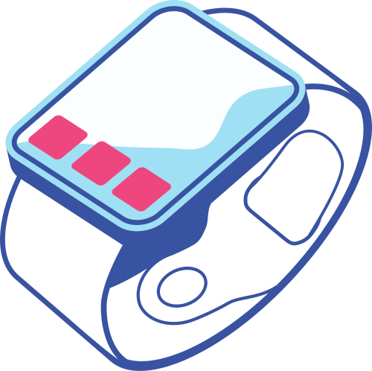
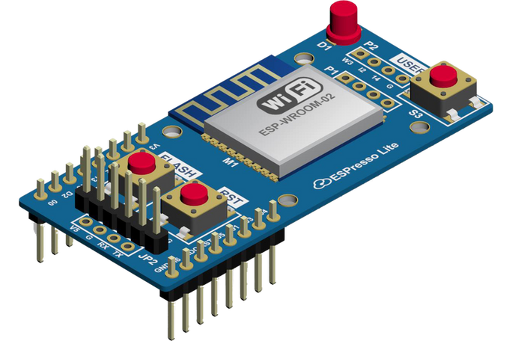
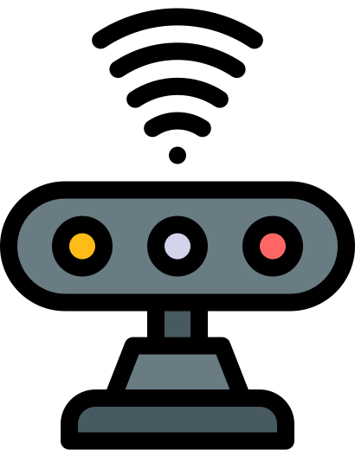
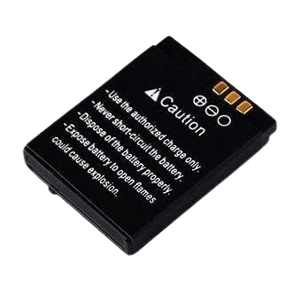
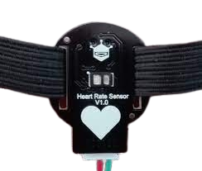
Smartwatch
electronic card esp32
WIFI sensor
battery
Heart Rate sensor

Slide 7
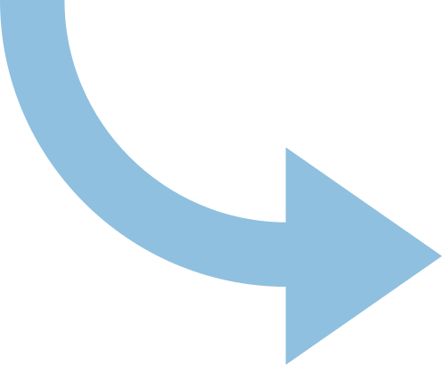

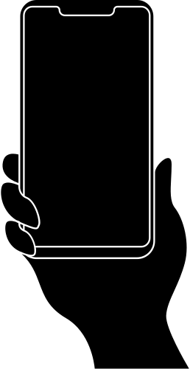
Data flow
Real Time Update
Real Time Update

Slide 8
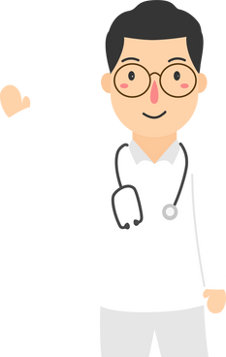

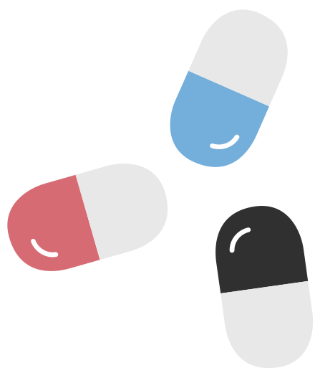
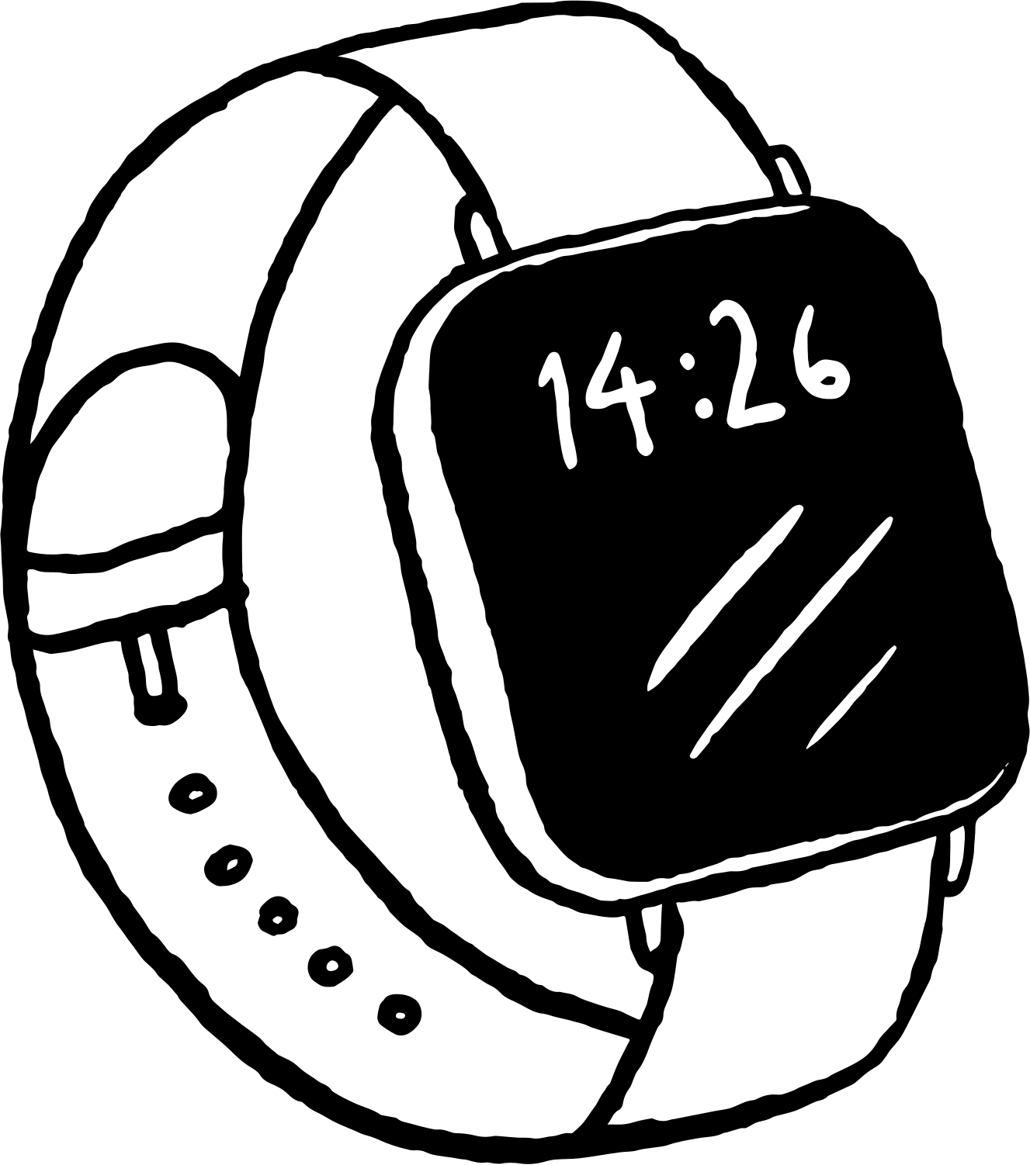
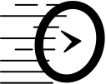


application features
multi
actors
Medication Management
Smartwatch Connectivity
real time
data sync
Health Reports
Authentification
secured

Slide 9
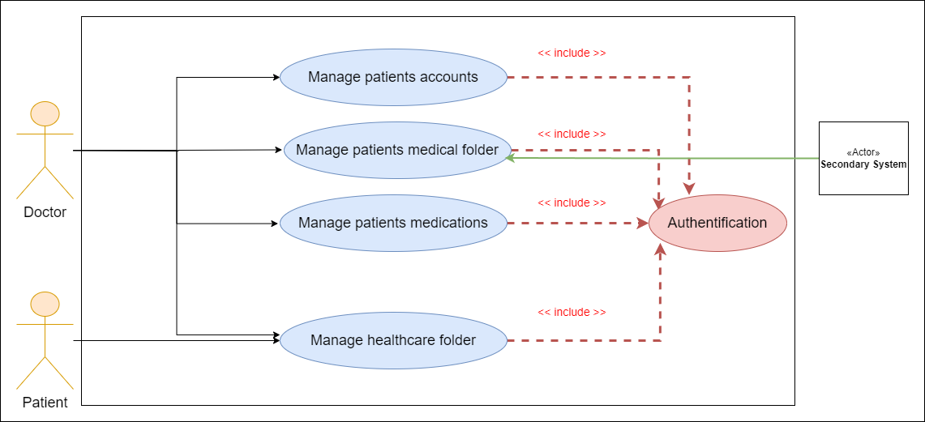
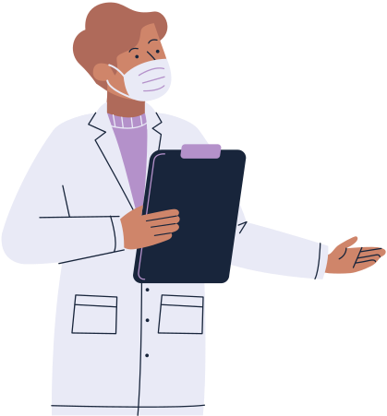
use case diagram

Slide 10
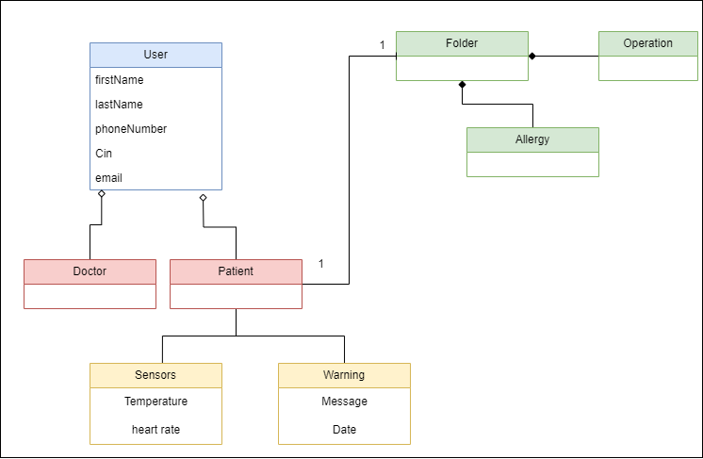
class diagram

Slide 11


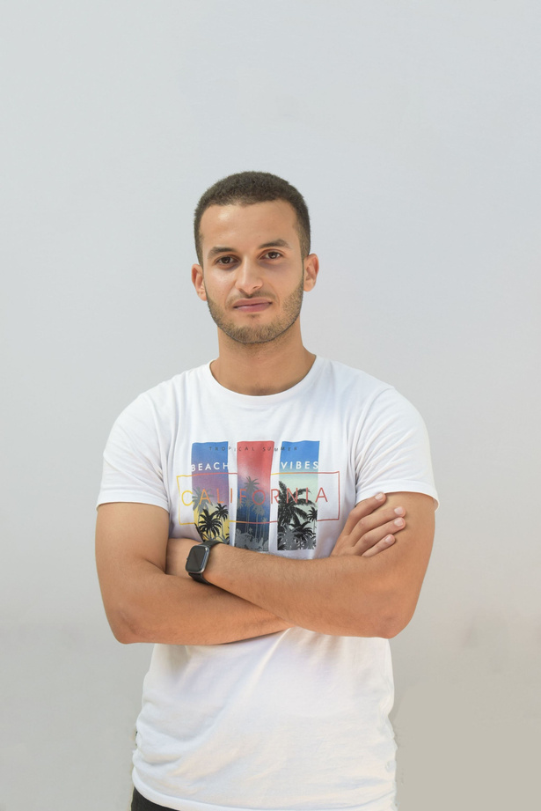
Our team
Hkimi Amin
Ghassen Ahmed
Wessim saidaini

Slide 12

THANK YOU!
happy to answer to your questions

